Slide 1
Constant envelope modulation
BFSK, MSK & GMSK

Slide 2
Introduction
Non-linear modulation : constant carrier amplitude regardless of variations in m(t).
Improved power efficiency without degradation in the occupied spectrum.
Use power efficient class C amplifiers (non-linear)
Low out of band radiation (-60 dB to -70 dB)
Use limiter discriminator detection
→ simplified receiver design
High immune against random FM noise and fluctuations from Rayleigh fading
larger occupied bandwidth than linear modulation

Slide 3
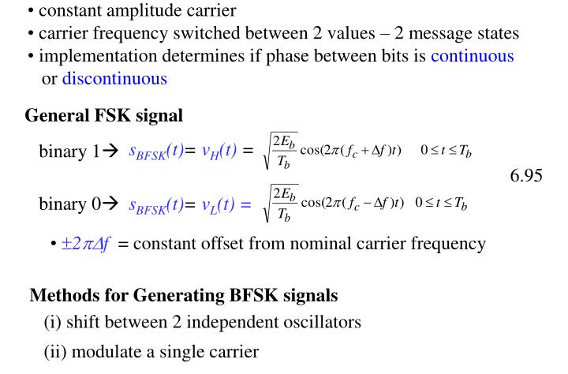
Binary FSK (BFSK)

Slide 4
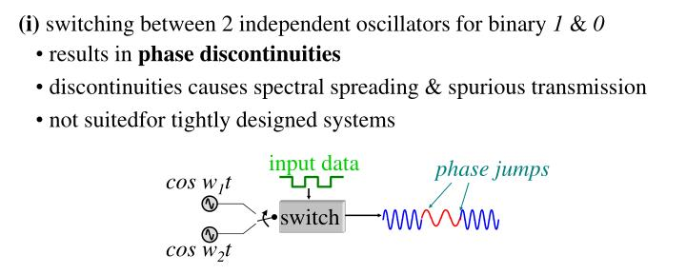

Slide 5
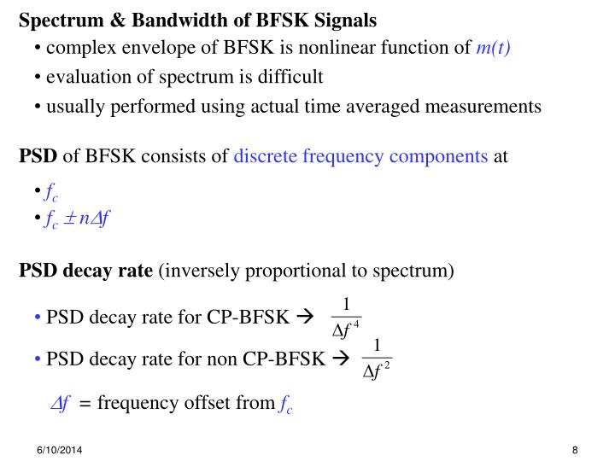

Slide 6
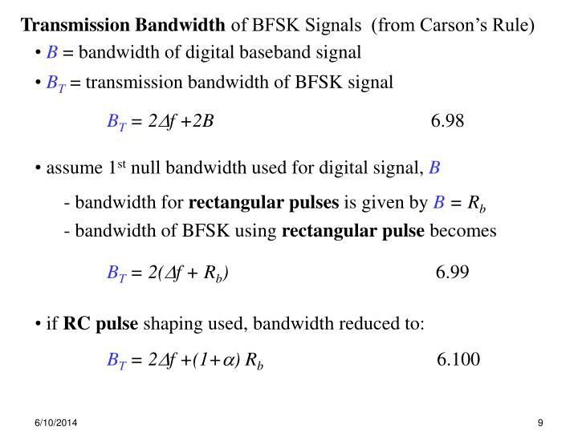

Slide 7
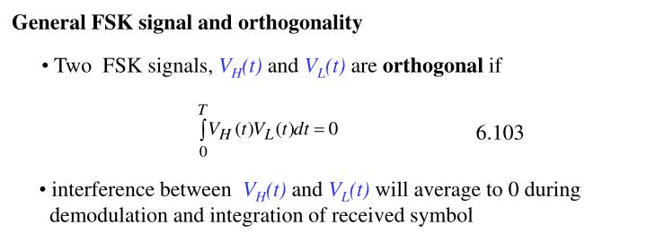

Slide 8
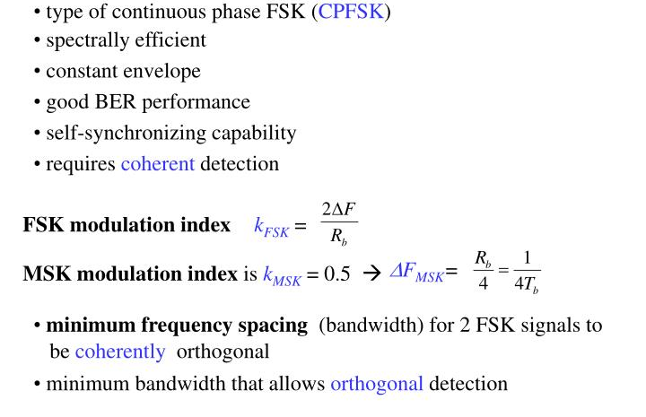
Minimum Shift Keying (MSK)
also called as Fast FSK

Slide 9
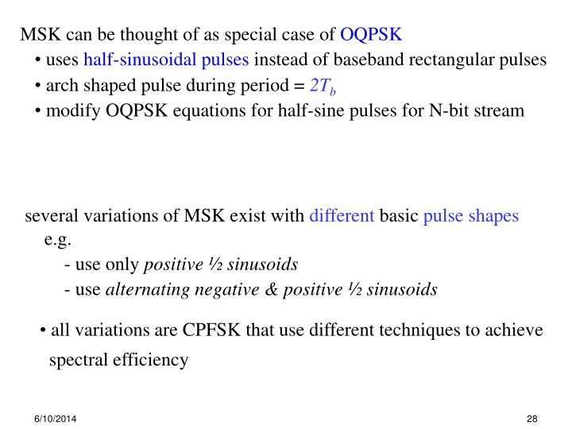

Slide 10
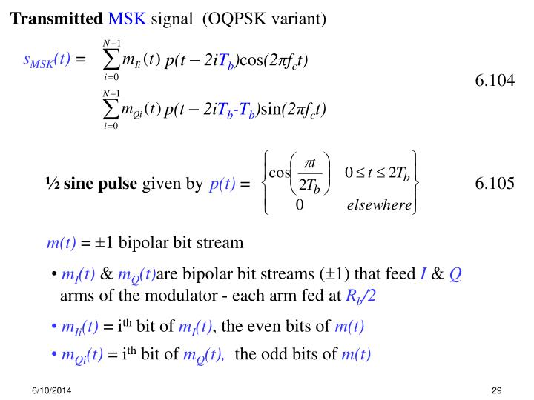

Slide 11
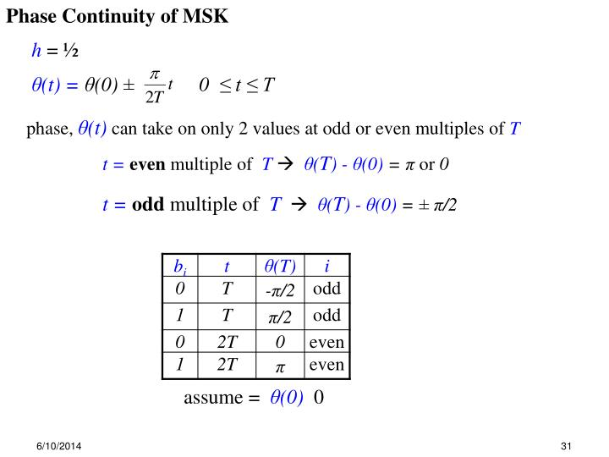

Slide 12
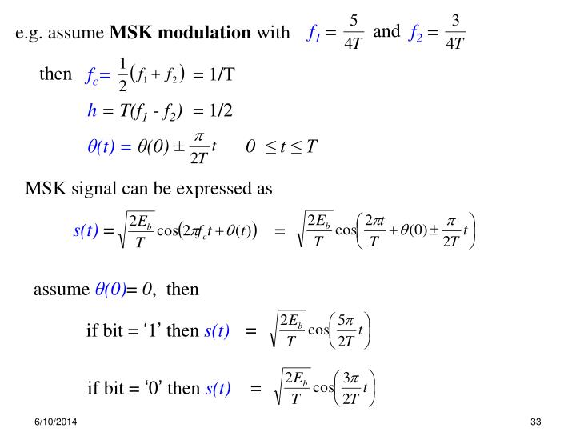

Slide 13
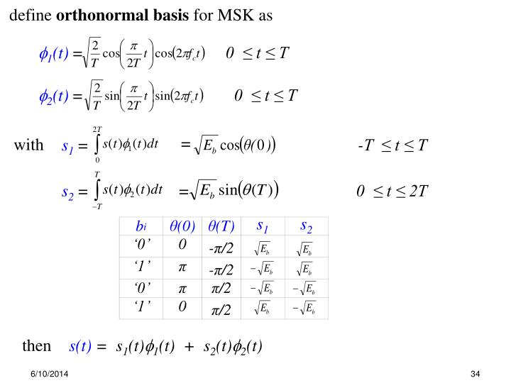

Slide 14
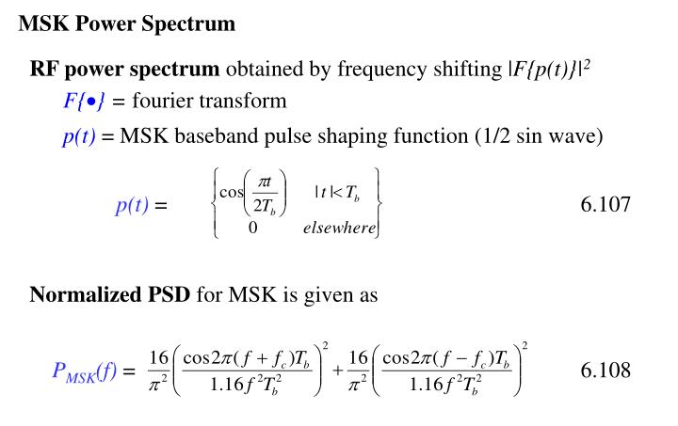

Slide 15
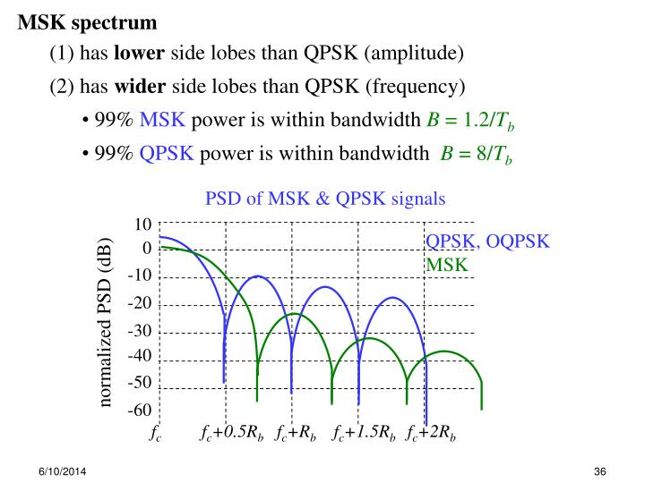

Slide 16
MSK sigificance
MSK has faster roll off due to smoother pulse function
Has no abrupt phase shifts at bit transitions
Does not raise out of band radiation levels
Due to constant amplitude, non-linear amplifiers can be used
Simple modulation and demodulation circuits.

Slide 17
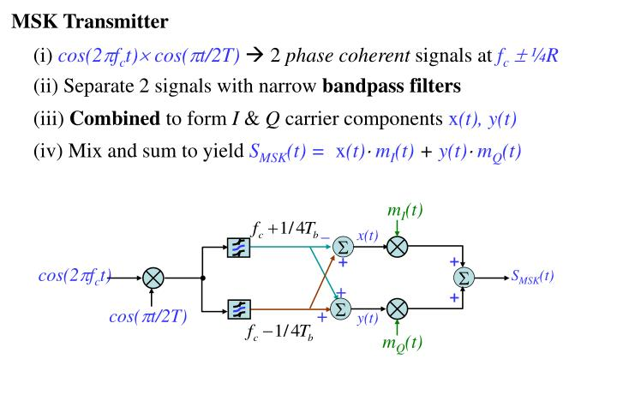
Pulse shaping function
2 phase coherent signals

Slide 18
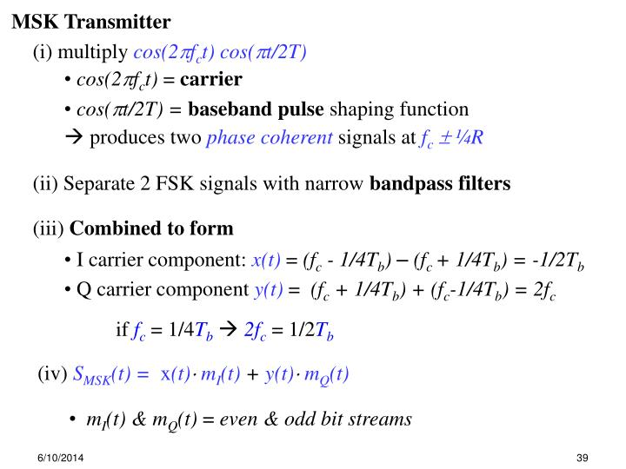

Slide 19
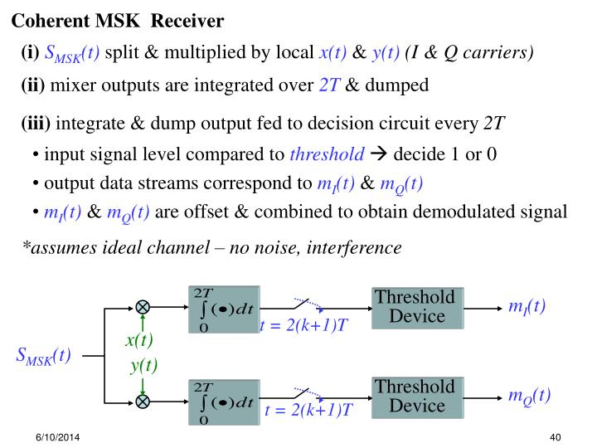

Slide 20
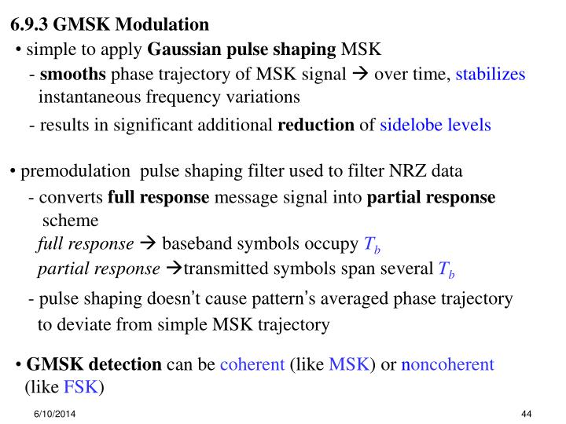

Slide 21
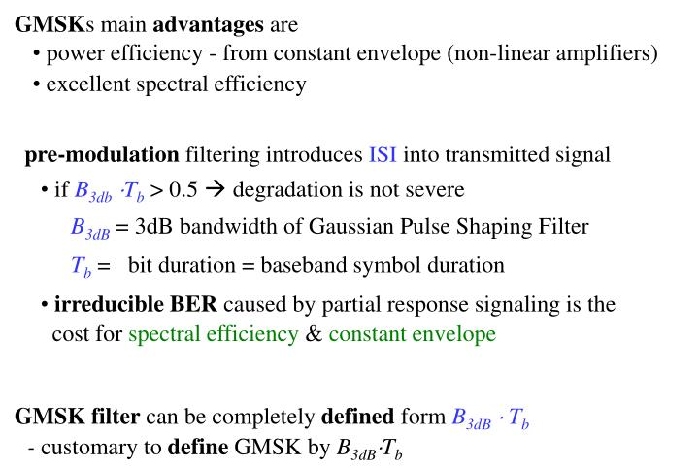

Slide 22
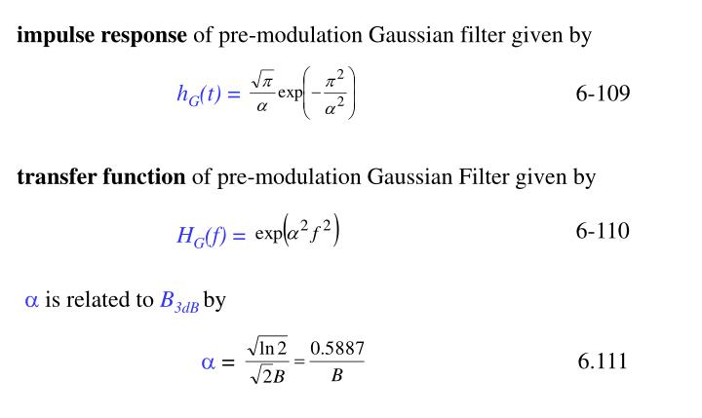

Slide 23
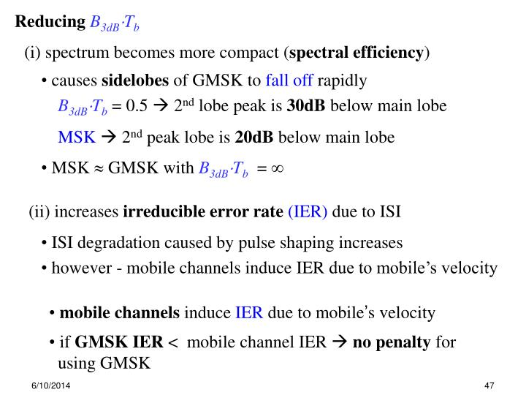

Slide 24
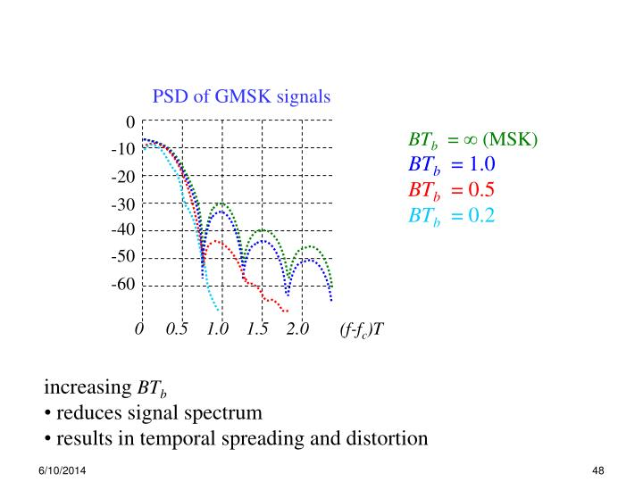

Slide 25
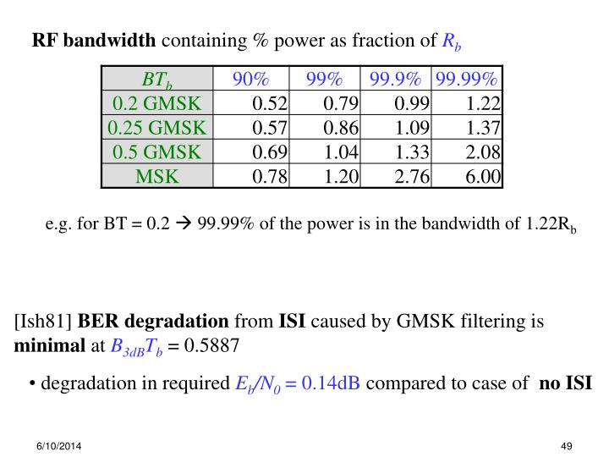

Slide 26
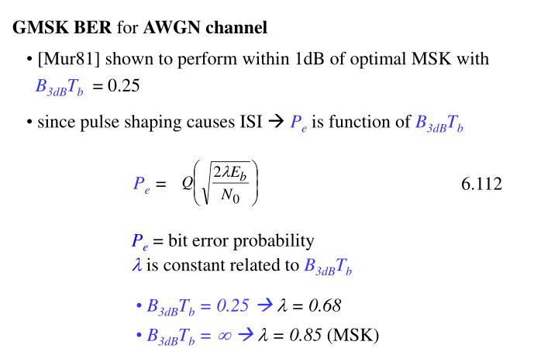

Slide 27
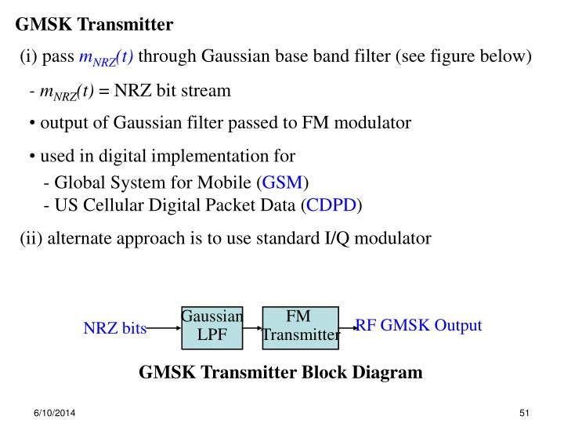
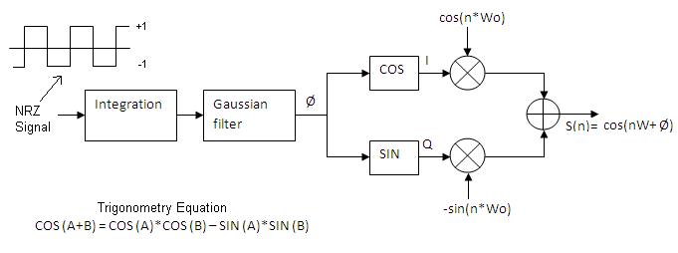

Slide 28
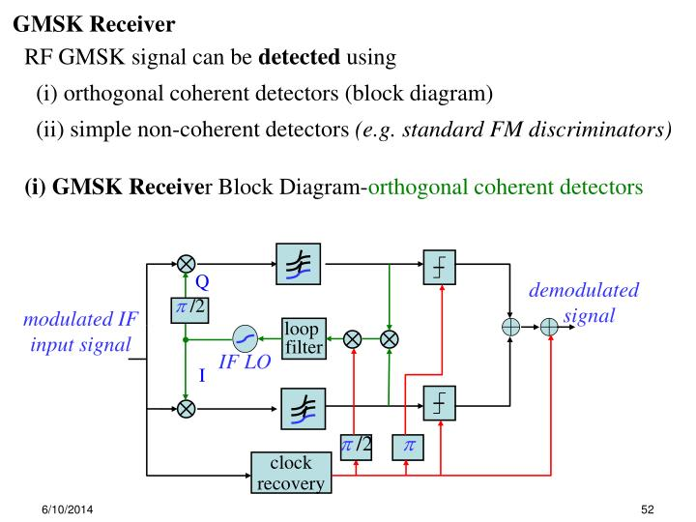

Slide 29
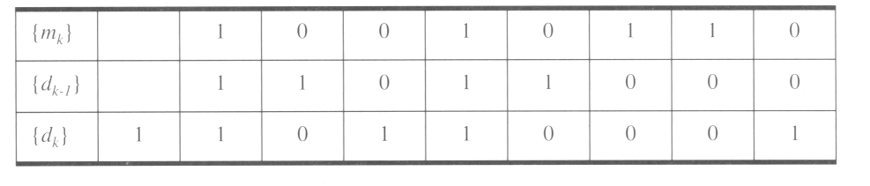
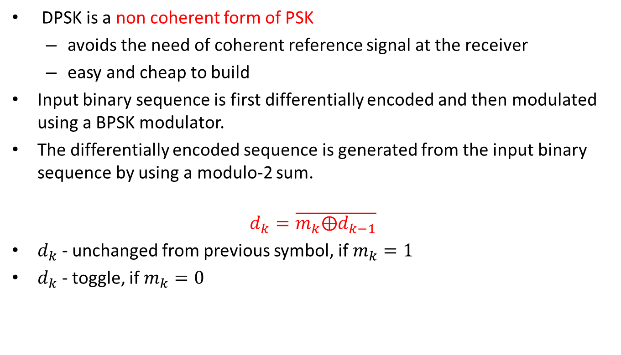
Differential PSK encoding (DPSK)
DPSK is a non coherent form of PSK
avoids the need of coherent reference signal at the receiver
easy and cheap to build
Input binary sequence is first differentially encoded and then modulated using a BPSK modulator.
The differentially encoded sequence is generated from the input binary sequence by using a modulo-2 sum.
$$d_{k}=\overline{m_{k}⨁d_{k−1}}$$
$d_{k}$- unchanged from previous symbol, if $m_{k}=1$
$d_{k}$- toggle, if $m_{k}=0$
1
0
1
1
0
0
0
1

Slide 30
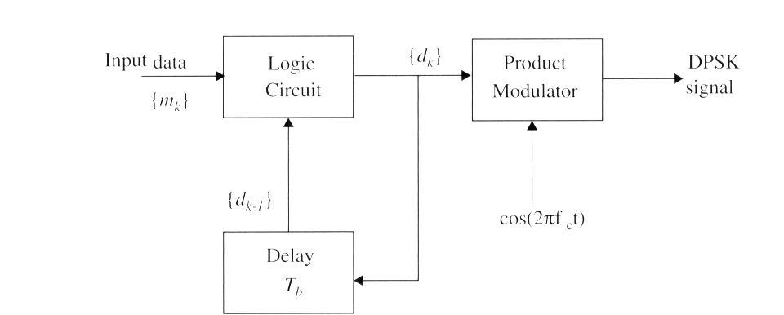
DPSK transmitter
Logic circuit and one bit delay element are interconnected
generate the differentially encoded sequence from the input binary sequence
Product modulator obtains DPSK signal

Slide 31
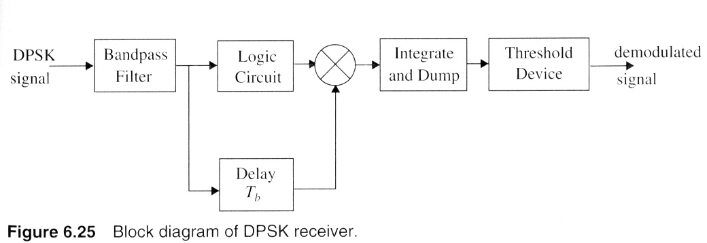

DPSK receiver
Original signal is recovered by reverse procedure.
Probability of bit error
$$P_{e,DPSK}=\frac{1}{2}exp\left(−\frac{E_{b}}{N_{0}}\right)$$

Slide 32
A mobile communication system uses a DBPSK modulation scheme (Tx sends 0 at the beginning of the transmission). Bit 0 is transmitted with phase and Bit 1 is transmitted with phase. If the following binary stream of data 0,0,1,1,0,1 has to be conveyed to the receiver. Which of the following is the correct bit stream that is sent to the transmitter after the Differential modulation?
0,0,0,1,0,0,1
0,0,0,1,0,1,1
1,1,1,0,1,1,0
1,1,1,0,1,0,0

Slide 33
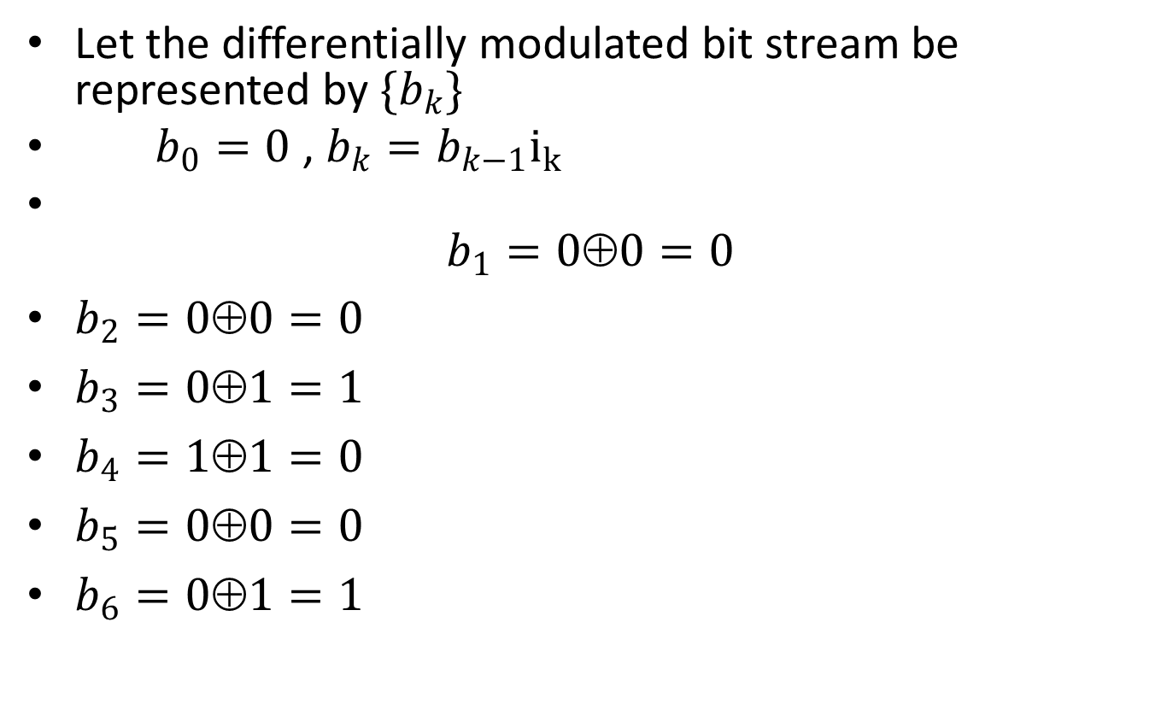
Let the differentially modulated bit stream be represented by $\{b_{k}\}$
$b_{0}=0$ , $b_{k}=b_{k−1}i_{k}$
$b_{1}=00=0$
$b_{2}=00=0$
$b_{3}=01=1$
$b_{4}=11=0$
$b_{5}=00=0$
$b_{6}=01=1$

Slide 34
Assume that θ₀=0⸰. The bit stream [ 0 0 1 0 1 1] is to be sent using π/4 DQPSK. The leftmost bits are first applied to the transmitter. Determine the phase of θ_{k} and the values of I_{k}, Q_{k} during transmission.

Slide 35
Consider a system that uses coherent QPSK modulation and detection scheme with 20 us symbol period for communication. The channel has a coherence time of 10 ms. If 100 symbols are being used for the purpose of channel estimation find the data rate?
160 kbps
100 kbps
80 kbps
40 kbps

Slide 36
Symbol period = 20us implies bandwidth = 50kHz
Because of QPSK, total bit rate = 2*50 = 100kbps
But every 10ms, 100 symbols (=200bits; because of QPSK) are being used for channel estimation and are unavailable for data transmission.
So, 200bits/10ms = 20kbps is used for channel estimation.
Data rate = 100kbps-20kbps = 80kbps

Slide 37
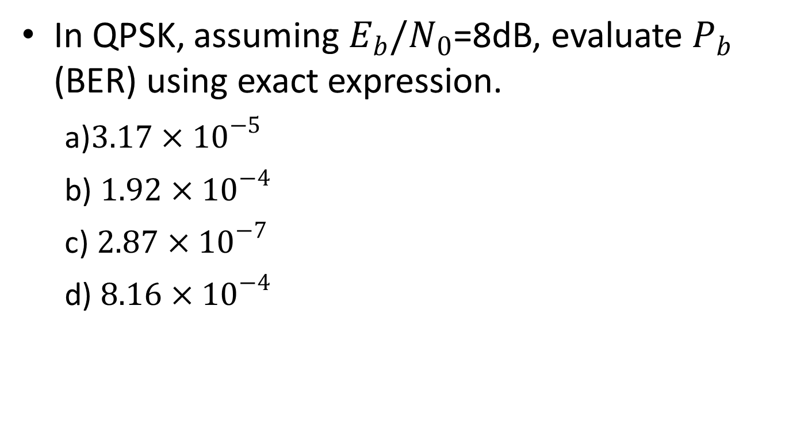
In QPSK, assuming $E_{b}/N_{0}$=8dB, evaluate $P_{b}$ (BER) using exact expression.
a)$3.17×{10}^{−5}$
b) $1.92×{10}^{−4}$
c) $2.87×{10}^{−7}$
d) $8.16×{10}^{−4}$

Slide 38
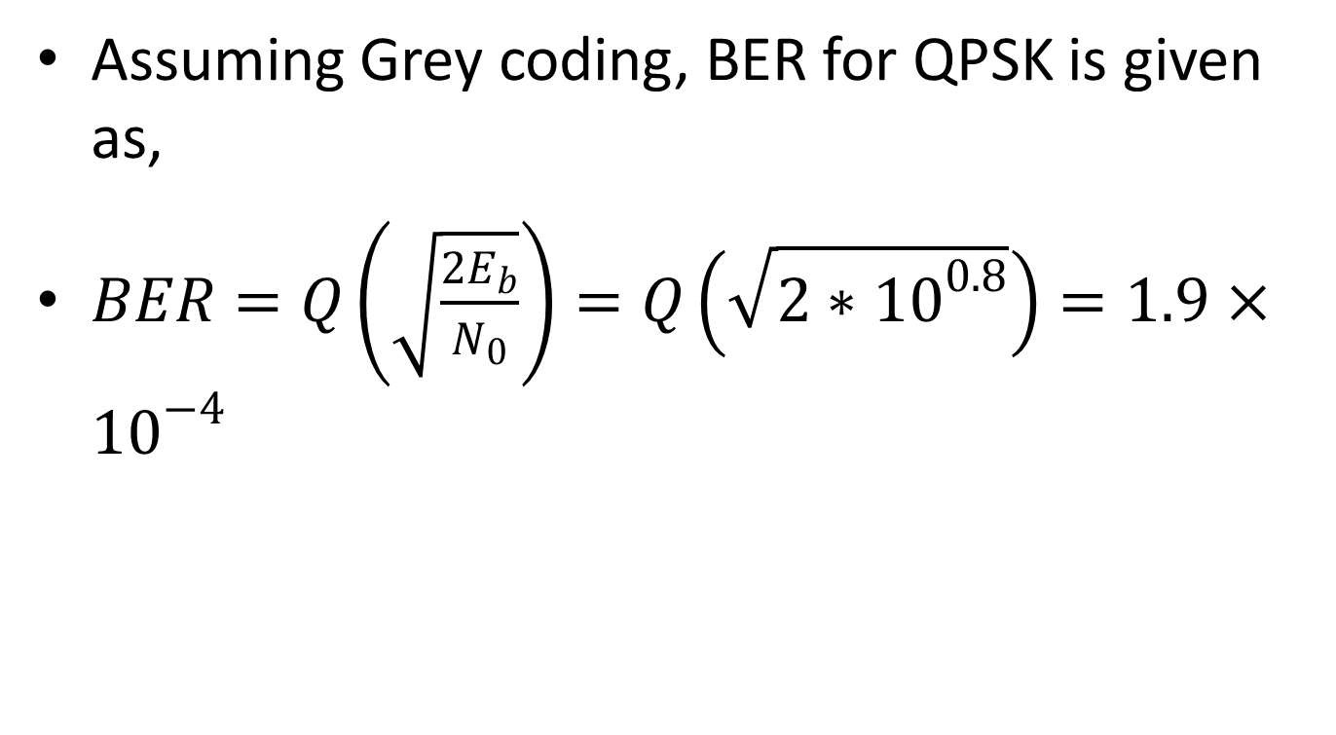
Assuming Grey coding, BER for QPSK is given as,
$BER=Q\left(\sqrt{\frac{2E_{b}}{N_{0}}}\right)=Q\left(\sqrt{2∗{10}^{0.8}}\right)=1.9×{10}^{−4}$

